Slide 1


CRIZOTINIB NELLA NEOPLASIA POLMONARE
Lucio Crinò
S.C. di Oncologia Medica
Azienda Ospedaliera di Perugia

Slide 2
Recent advances in cancer biology
The genomic map are redesigning the tumor taxonomy by moving from a histology to a genetic based level
Somatic genetic alterations are legitimate targets for therapy
Tumor specific DNA alterations represent highly sensitive biomarkers for disease detection and monitoring
Tumor genotyping allows to individualize treatments by matching patients with the best treatment for their tumors

Slide 3
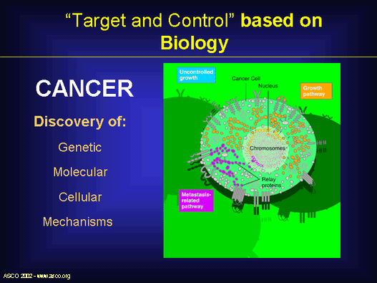
Uncontrolled
growth
Growth
pathway
Metastasis-
Related
pathway

Slide 4
Potential “Druggable” Molecular Targets
Human genes (~ 24.000)
Disease genes (~ 1.700) Druggable genes (~ 3.000)
Druggable disease genes (~ 520)

Slide 5
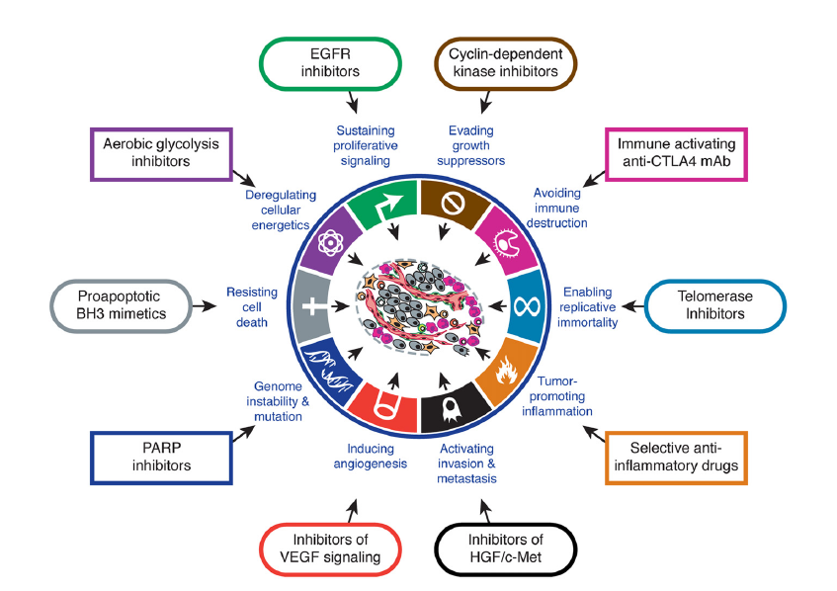
Therapeutic targeting of the hallmarks of cancer
Hanahan D, Weinberg RA. Cell 2011; 144:646

Slide 6
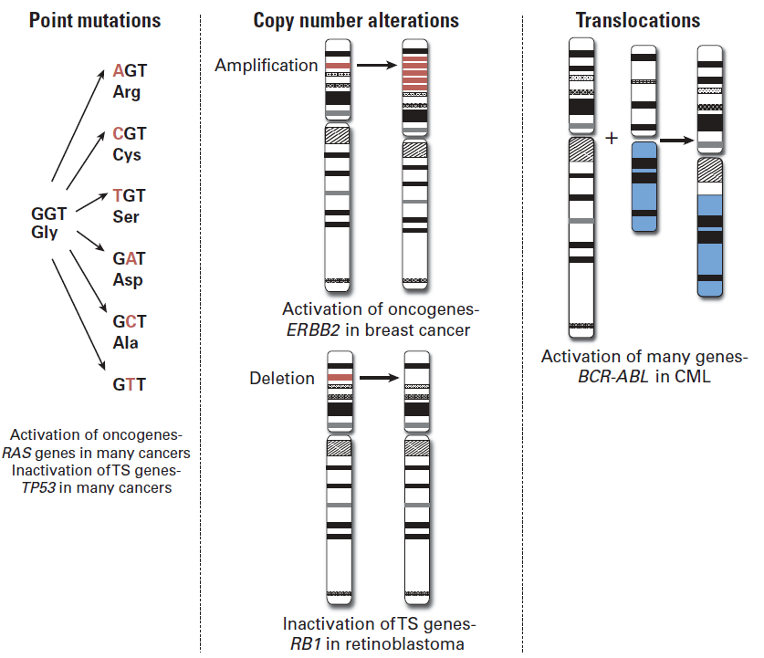
The major classes of genomic alterations that give rise to cancer
FISH,
Immunohistochemistry
Sequencing,
Real Time PCR
etc.
EGFR
ErbB-2
MET
EGFR
ErbB-2
BRAF
PIK3CA
AKT1
MAP2K1
EML4-ALK
ROS-1
RET
Modified from McConaill JCO 2010

Slide 7
Normanno J Cell Biochem 2012

Slide 8
ONCOGENE ADDICTION
Some cancers that contain multiple genetic, epigenetic and chromosomal abnormalities are dependent to one or a few genes for both maintenance of the malignant phenotype and cell survival
ERB-B2 in breast cancer
EGFR in NSCLC
EML4-ALK in NSCLC
ROS1 in NSCLC
BRAF in NSCLC and melanoma-KIT in GIST
RET in medullary thyroid cancer
RET in NSCLC
HIF/VEGF in renal cancer
Weinstein Science, 2002

Slide 9
WORLDWIDE APPROVED MOLECULAR DRUGS FOR CLINICAL PRACTICE
Targets | Diseases | Drugs
EGFR | Lung adenocr. | Gefitinib Erlotinib
C-KIT | LMC – GIST | Imatinib
ALK-Translocation ROS Rearrangement | Lung adenocr. | Crizotinib
B-RAF | Melanoma Lung adenocr. | Vemurafenib
HER-B2 | Breast cancer Gastric cancer Lung adenocr. | Trastuzumab
VEGF-R | Lung, colorectal, ovarian, breast, gliomas and renal cancers | Bevacizumab Sorafenib Sunitinib
RET | Thyroid cancer | Vandetanib

Slide 10

The burden of NSCLC
Lung cancer in Europe:
292 000 new cases
253 300 deaths
Lung cancer worldwide:
1.5 million new cases
1.18 million deaths
NSCLC accounts for >80% of lung cancers
Parkin D, et al. CA Cancer J Clin 2005;55:74–108; Ferlay J, et al. Ann Oncol 2007;18:581–592

Slide 11
‘Longer life’ . . . are we meeting the objective?
Therapeutic plateau has been reached; new CHT combinations unlikely to further improve survival
Chemotherapy combinations have failed to substantially improve median OS beyond 8–10 months
Platinum-based doublets:
8–10 months
Single-agent platinum:
6–8 months
BSC:
2–5 months
0 2 4 6 8 10 12 14
Median survival (months)
Schiller, et al. NEJM 2002
Sandler, et al. NEJM 2006
Notes:
11
2)Chemotherapy combinations have failed to substantially improve median OS beyond 8–10 months. new strategies are needed to overcome this therapeutic plateau

Slide 12
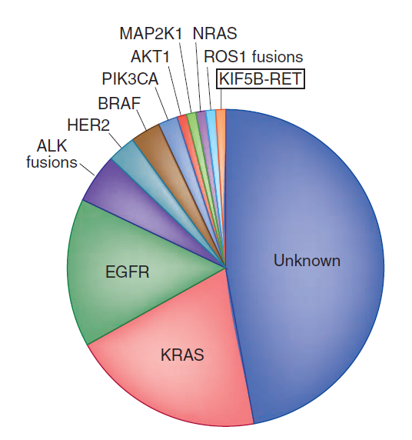
Molecular subsets of lung adenocarcinoma
Pao & Hutchinson Nat Med 2012

Slide 13

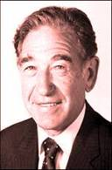
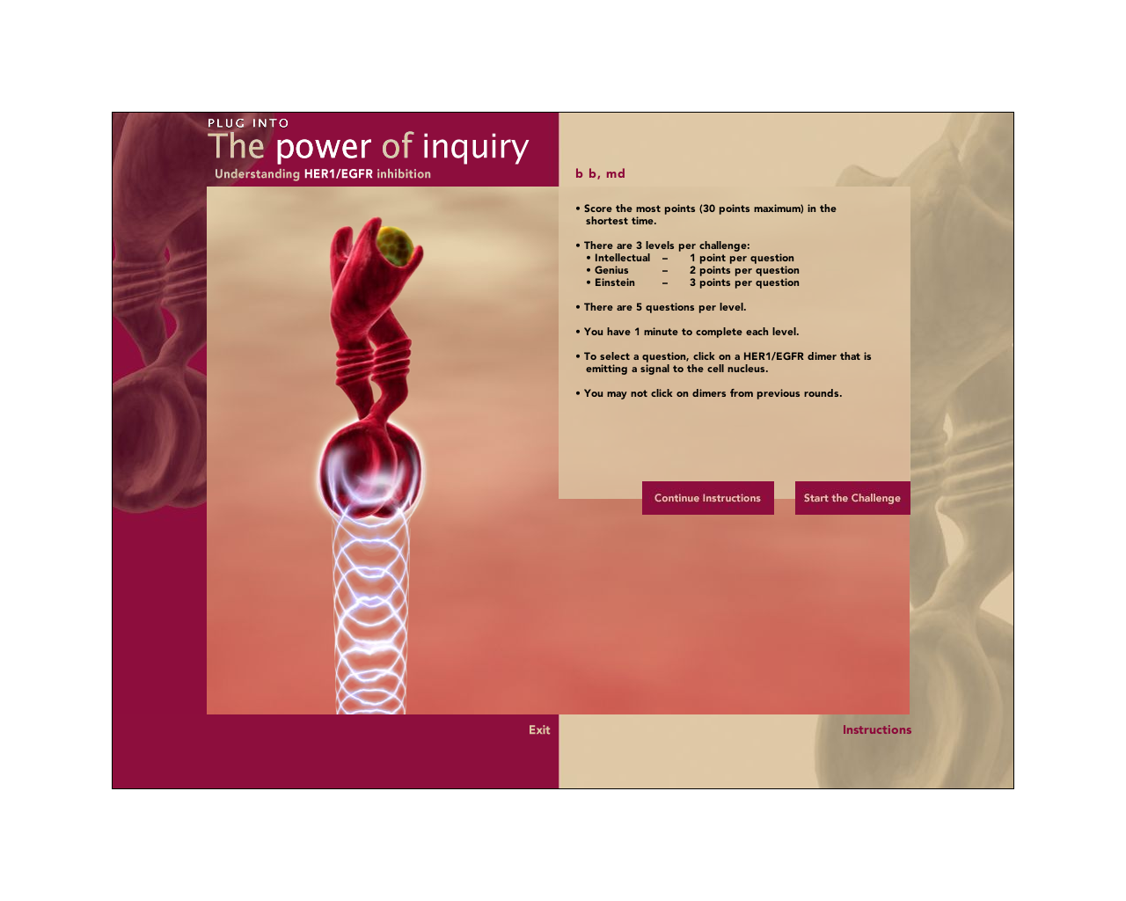

Pioneers and milestones: evidence that EGFR is important in NSCLC biology
1980
1984
Isolation of human
EGF receptor (EGFR) by Stanley Cohen
Human EGFR
gene cloned and sequenced
Cohen S, et al. J Biol Chem 1980
Ullrich A, et al. Nature 1984
1930
1940
1950
1960
1970
1980
1990
2000
2010

Slide 14
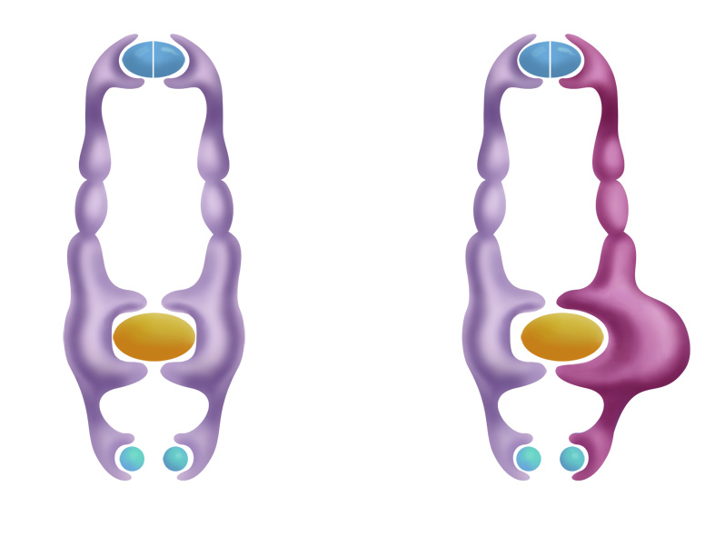
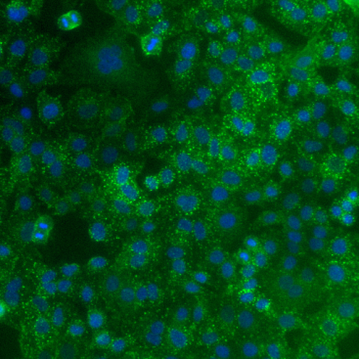
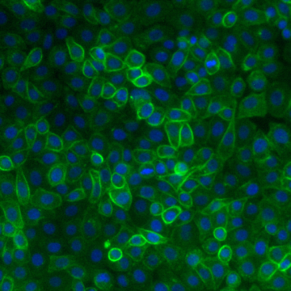
EGFR mutation causes conformational change and increased activation
Wild-type EGFR
Mutant EGFR
Ligand
Extracellular domain
Trans-membrane domain
Tyrosine kinase domain
ATP
Tyrosine phosphorylation
Ras-Raf-MAPK
Proliferation
Pi3K-AKT
Survival
EGFR internalisation
Degradation / recycling
EGFR signals for longer
at the cell membrane
Arteaga 2006; Gadzar et al 2004; Hendricks et al 2006; Sordella et al 2004
Notes:
References
Arteaga C. Cancer Cell 2006; 9: 421-423.
Gazdar AF et al. Trends Mol Med 2004; 10: 481-486.
Hendricks BS et al. Systems Biology 2006; 153: 457-466.
Sordella R et al. Science 2004; 305: 1163-1167.
14

Slide 15
Common mutation sites in the EGFR gene
Regulatory domain
ATP binding
cleft
Transmembrane
region
Extracellular
domain
C-lobe
N-lobe
TK domain
A-loop
αChelix
P-loop
21
20
19
18
Lynch et al, 2004; Paez et al 2004
Notes:
15
References
Lynch TJ et al. NEJM 2004; 350: 2129-39.
Paez JG et al. Science 2004; 304: 1497-500.

Slide 16
EGFR-TKI vs. chemotherapy for EGFR-mutant NSCLC
Study | EGFR-TKI | EGFR mut | Population | RR (EGFR-TKI vs chemo) | PFS (EGFR-TKI vs chemo)
WTOG 3405 (N=172) | Gefitinib | del 19 or L858R | Asiatic | 62.1% vs. 32.2% P<.0001 | 9.2 vs. 6.3 months P<.0001 – HR=0.48
NEJ002 (N=224) | Gefitinib | All | Asiatic | 73.7% vs. 30.7% P<.001 | 10.8 vs. 5.4 P<.001 – HR=0.32
OPTIMAL (N=154) | Erlotinib | del 19 or L858R | Asiatic | 83% vs. 36% P<.0001 | 13.1 vs. 4.6 months P<.0001 – HR=0.16
EURTAC (N=173) | Erlotinib | del 19 or L858R | Caucasian | 63.6% vs. 17.8% P<.0001 | 9.7 vs. 5.2 months P<.0001 – HR=0.37
LUX-Lung 3 (N=345) | Afatinib | All | Mixed* | 56.1% vs. 22.6% P<.001 | 11.1 vs. 6.9 months P=.0004 – HR=0.58
*72% Asiatic
WTOG 3405: Mitsudomi, et al. Lancet Oncol 2010
NEJ002: Maemondo, et al. NEJM 2010; Inoue, et al. ASCO 2012
OPTIMAL: Zhou, et al. Lancet Oncol 2011
EURTAC: Rosell et al. Lancet Oncol 2012
LUX-Lung 3: Yang, et al. ASCO 2012

Slide 17
Status of Actionable Driver Mutations in Lung Adenocarcinoma Tumor Specimens
No mutation detected
NRAS<1%
KRAS (22%)
MEK1<1%
EGFR (18%)
MET AMP<1%
EML4-ALK (7%)
HER2 1%
Double mutants (2%)
PIK3CA 1%
Alk Fusion Prevalence in NSCLC: Retrospective Data
BRAF (2%)
AKT1
 | RT-PCR | FISH | IHC
% ALK+ patients Unselected | 1.6%¹ - 4.9%² | 2.7%³ - 4.2%⁴ | 1.7%⁵ - 8.6%⁶
% ALK+ patients Adenocarcinoma | 2.4%⁷ - 4.9%² | 5.6%⁸ | 2.7%⁵
¹Takahashi, et al. 2010. ²Wong, et al. 2009. ³Perner, et al. 2008.
⁴Paik, et al. 2011. ⁵Boland, et al. 2009. ⁶Paik, et al 2011. ⁷Takahashi, et al. 2010.
⁸Rodig, et al. 2009.
Johnson D, et al. ECCO ESMO 2011. Abstract 9018.
Notes:
And on the other site the “pie of adenocarcinoma” is more and more covered with new slices, leaving day by day less undiscovered diseases, if you consider that in the trial that I discuss today the authors detected a driver mutation in more than 50% of the evaluable DNA.
The Lung Cancer Mutation Consortium is one example of oncogenic platform in lung cancer, evaluating 10 biomarkers in paraffin embedded tissue from 1000 pts with adenoca
RETROSPECTIVE: Incidence rates are influenced by sample size, screening methods and enrichment prior to pre-selection
CLIA, Clinical Laboratory Improvement Amendments; EGFR, epidermal growth factor receptor.
For more information, please go online to: http://www.clinicaloptions.com/Oncology/Conference%20Coverage/Clin%20Onc%20June%202011/Tracks/Thoracic/Capsules/CRA7506.aspx

Slide 18




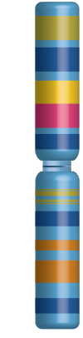



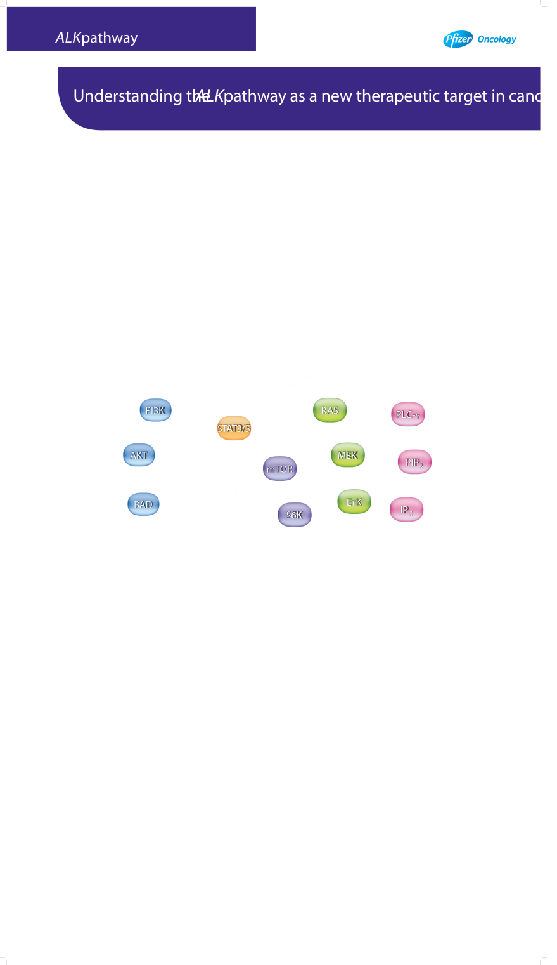
ALK Pathway
See alternative slide in back-up (slide 28)
Or
Inversion
Translocation
ALK
ALK fusion protein*
Partner gene product
PI3K
RAS
PLC-_{Y}
STAT3/5
AKT
mTOR
MEK
PIP₂
BAD
ErK
IP₃
S6K
Cell
survival
Tumour cell
proliferation
*Subcellular localisation of the ALK fusion gene, while likely to occur in the cytoplasm, is not confirmed.^{1,2}
BAD, BCL2-associated agonist of death; STAT3, signal transducer and activator of transcription 3; S6K, ribosome protein S6 kinase;
ERK, extracellular signal-regulated kinase.
¹Inamura K, et al. J Thorac Oncol. 2008;3:13–17. ²Soda M, et al. Proc Natl Acad Sci. U S A. 2008;105:19893–97.
Figure based on: Chiarle R, et al. Nat Rev Cancer. 2008;8(1):11–23. Mossé YP, et al. Clin Cancer Res. 2009;15(18):5609–14; and Pfizer Inc, data on file.
Notes:
18

Slide 20
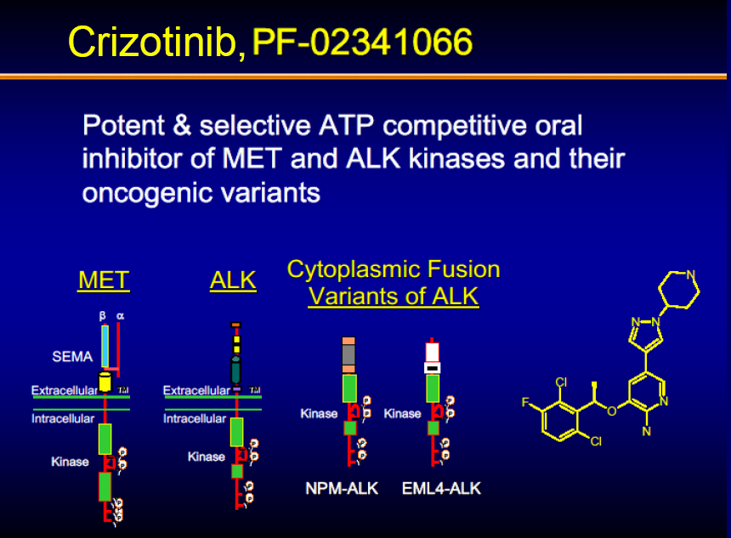

Slide 21

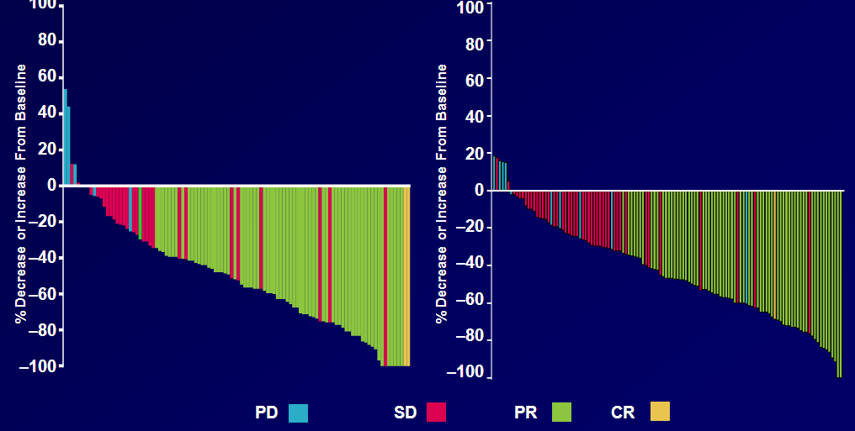
Tumor responses to crizotinib by patient
PROFILE 1001¹
PROFILE 1005²
Median time to response: 8 wk
1. Camidge et al., ASCO 2011; Abs #2501
2. Riely et al., IASLC 2011; Abs #O31.05
Notes:
From Global Lung Council

Slide 22
PFS of Crizotinib vs Pemetrexed or Docetaxel
100
 | Crizotinib (n=172ª) | PEM (n=99^{b}) | DOC (n=72^{b})
Events, n (%) | 100 (58) | 72 (73) | 54 (75)
Median, mo | 7.7 | 4.2 | 2.6
HR^{c} (95% CI) |  | 0.59 (0.43 to 0.80) | 0.30 (0.21 to 0.43)
P |  | <0.001 | <0.001
80
60
Probability of survival without progression (%)
40
20
0
0 5 10 15 20 25
No. at risk
Crizotinib
PEM
DOC
Time (months)
172 93 38 11 2 0 99 36 12 3 1 0 72 13 3 1 0
ªExcludes 1 patient who did not receive study treatment; ^{b}excludes 3 patients in chemotherapy arm who did not receive study treatment; ^{c}vs crizotinib

Slide 23
ROS1 Rearrangements in NSCLC
TPM3-ROS1
Present in ~1% of NSCLC cases (also found in some GBMs and cholangiocarcinomas)
Enriched in younger never or light smokers with adenocarcinoma histology
No overlap with other oncogenic drivers
SDC4-ROS1
SLC34A2-ROS1
CD74-ROS1
EZR-ROS1
LRIG3-ROS1
ROS1
Bergethon et al., JCO 30(8): 863-70, 2012; Takeuchi et al., Nat Med 18(3): 378-81, 2012

Slide 24
Summary of Tumor Responses in Patients with Advanced ROS1+ NSCLC (N=14*)
100
80
PD
SD
PR
CR
60
40
20
†
‡
Decrease or Increase From Baseline (%)
0
15+
–20
16+
18+
–40
4+
12+
–60
8+
22+
18
44+
–80
–100
20+
35+
48+
*Response-evaluable population. †Tumor ROS1 FISH-positive, but negative for ROS1 fusion gene expression. ‡Crizotinib held for >6 wks prior to first scans which showed PD. +, Treatment ongoing. For ongoing patients, duration of response/SD is the time from first documentation of tumor response/first dose to last available on treatment scan. For discontinued patients, duration is to the time of PD or death. Duration is in weeks.
Data in the database as of April 19, 2012

Slide 25
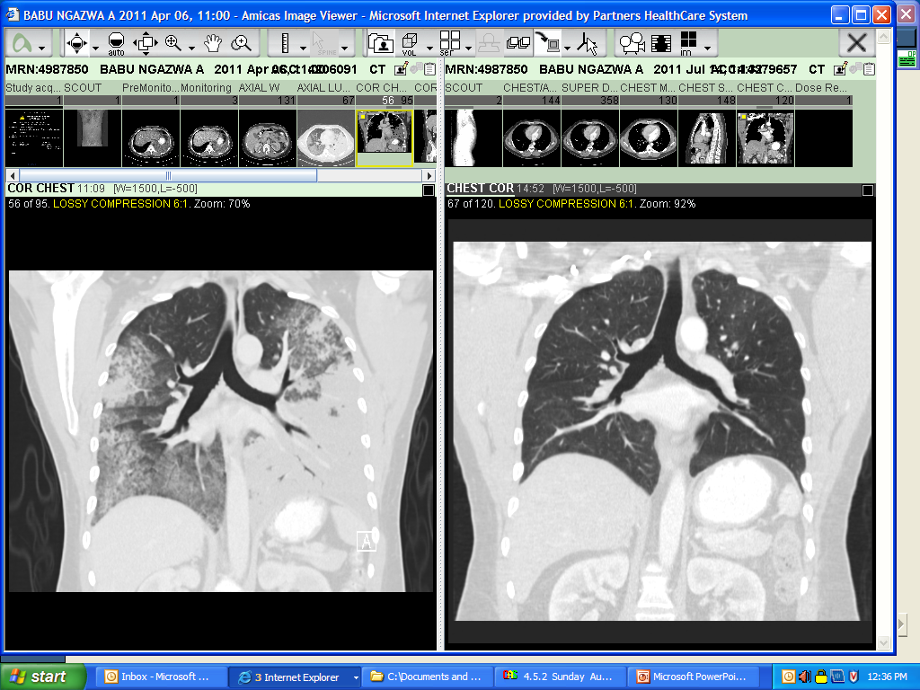
Significant Responses to Crizotinib in Patients with ROS1-Positive NSCLC
Baseline
After 3 months of crizotinib
Bergethon et al., JCO 30(8): 863-70, 2012

Slide 26
Case Report
46-ys-old light ex-smoker woman
June 2011 superior right lobectomy + lymphadenectomy for G3 lung adenocarcinoma Stage IA (pT1aN0MO, TMN 7° edition). The subsequent radiological controls were negative until June 2012.
June 2012: A CT scan showed disease recurrence with multiple bilateral mediastinal nodes
Molecular Analysis: EGFR and K-RAS wild type, FISH for EML4-ALK negative, ERCC1 high, TS low; ROS1 rearrangement positive
June-July 2012: After 2 cycles of ciplatin + pemetrexed → nodal disease progression and appearance of pericardial effusion
20 August 2012: Patient was started on crizotinib 250 mg x 2

Slide 27
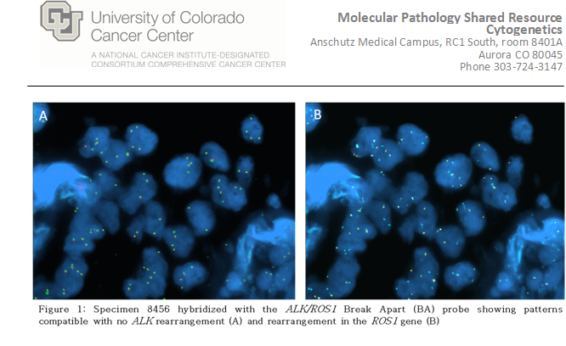

Slide 28
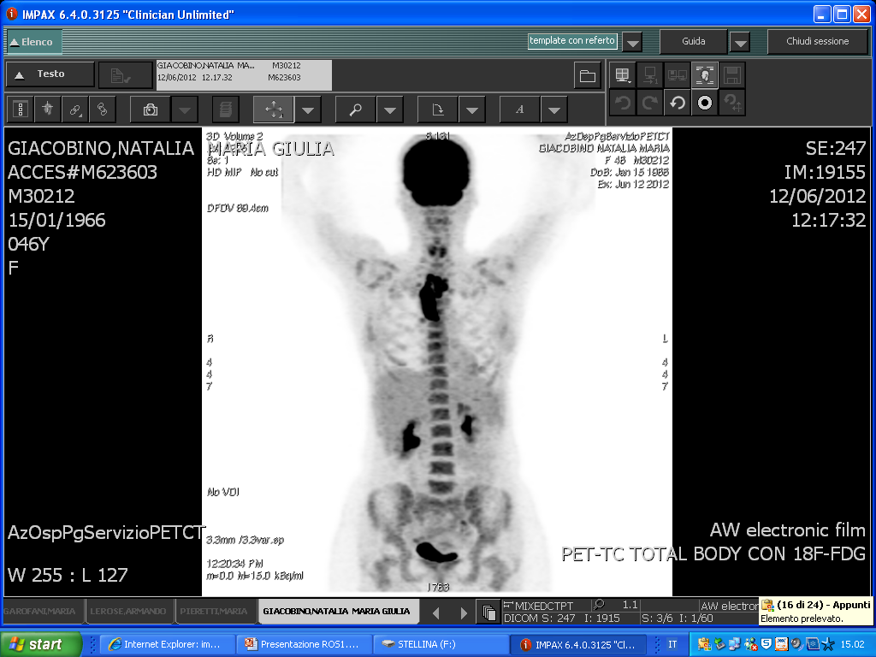
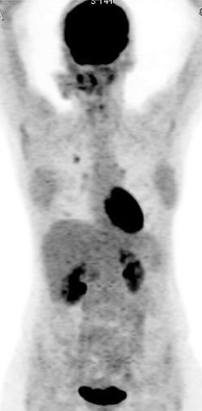
August 2012: Start crizotinib
After 1 month of crizotinib
Almost disappeared

Slide 29
Cancer research at the roundabout
Cancer is a genetic somatic disease (5% inherited)
It originates from stem cells
It is caused by genetic alterations of a handful of genes
It is often possible to identify these genetic lesions by molecular diagnosis
“Target” therapy is only effective when aimed at the alteration of the driver gene (s)

